Slide 1
Unemployment Insurance for the Elderly
2024. 04. 19
Ji-Woong Moon(KIPF)

Slide 2
Introduction
Unemployment Insurance (UI) serves as a safety net for the unemployed, aiding in consumption smoothing
Generally provided to individuals meeting specific requirements
In the US, eligibility entails consistent work history and earning a minimum amount in the past 12-24 months, coupled with ongoing job search.
Similar requirements are observed in Korea.
Differences in maximum age restrictions
US has no age restrictions, while Korea restricts eligibility to those under 65.
Countries like Ireland, Spain, and Finland share Korea's strict age limit policy, while the UK and France tie age limits to social security.
Some countries like the US, Japan, and Italy have no age restrictions.

Slide 3
Introduction
Aging societies necessitate extended work into elderly years
In Korea, the labor force participation rate for those over 65 rose from 54.1% in 2013 to 60.2% in 2023.
With prolonged work, the necessity for extended UI provision arises.
Korea faces a relatively high elderly poverty ratio, highlighting the need for financial support for the elderly
The elderly poverty rate was 40.4% in 2023, ranked 1st among OECD countries
However, the substantial labor supply elasticity suggests a significant adverse effect of UI on the elderly.

Slide 4
Introduction
This project aims to discuss whether UI for the elderly is efficient
Fairness and equality are not the focus
A key trade-off concerning UI is insurance-incentive trade-off
Prolonged work into old age and a high poverty rate among the elderly imply a larger insurance effect, favoring a higher UI level.
A larger labor supply elasticity suggests a larger moral hazard effect, implying a lower UI level.
Utilizing the Baily-Chetty framework to evaluate the efficiency of the elderly UI

Slide 5
Labor Force Participation Rate
Increasing trends in the labor force participation rate for ages 50~59 and 60+

Slide 6
Unemployment rate
The average level is lower, but much more volatile than that of the prime-aged

Slide 7
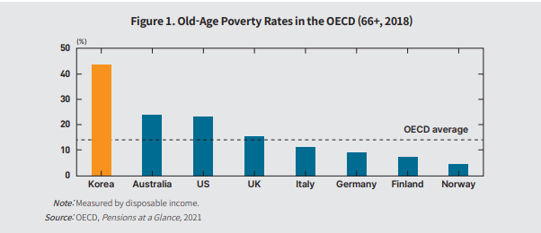
Old-Age Poverty Rates in the OECD
Old-age poverty rate is high in Korea

Slide 8
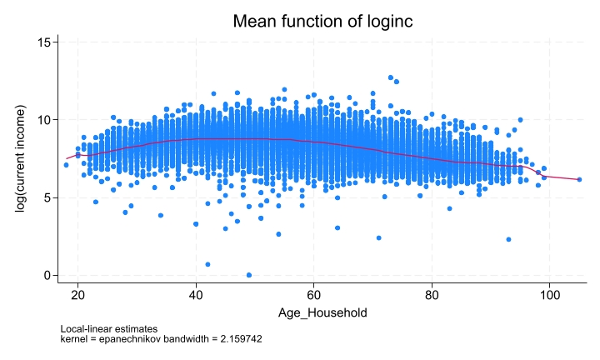
Current Income and Wage
Hump-shaped income profile over head’s age

Slide 9
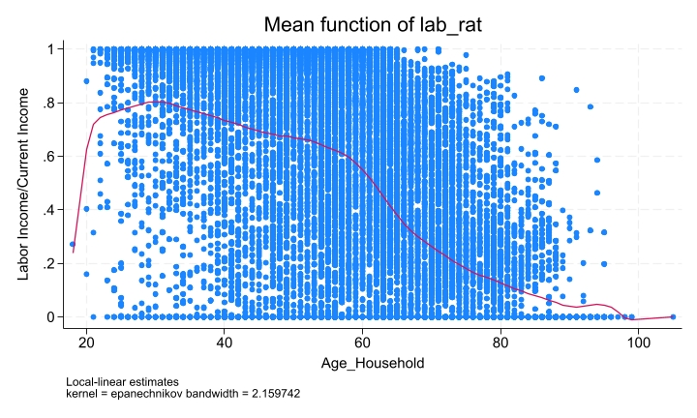
Labor Income Ratio
Labor Income/Current Income falls drastically after 60

Slide 10
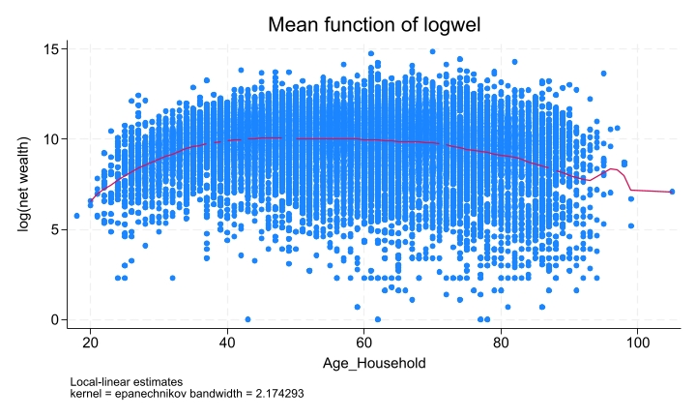
Net Wealth
Hump-shaped wealth profile over head’s age

Slide 11
Summary
The elderly are more likely to be marginal workers
Lower labor force participation rate & volatile unemployment
Potential cost associated with introducing unemployment insurance
The elderly earn relatively less in total, and much less through labor income
Their lower income is not compensated by wealth
Net wealth is also hump-shaped over the head’s age
Potential benefits of unemployment insurance
These suggest both the necessity and adverse effects of UI

Slide 12
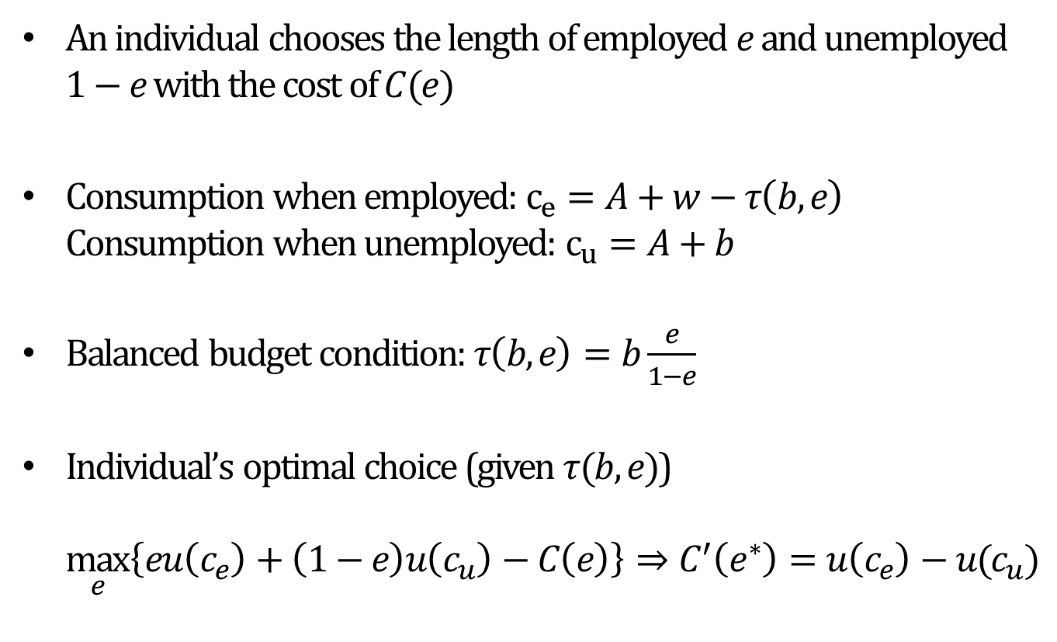
Simple Labor Market Model
An individual chooses the length of employed $e$ and unemployed $1−e$ with the cost of $C(e)$
Consumption when employed: $c_{e}=A+w−τ\left(b,e\right)$ Consumption when unemployed: $c_{u}=A+b$
Balanced budget condition: $τ\left(b,e\right)=b\frac{e}{1−e}$
Individual’s optimal choice (given $τ(b,e)$) $\max_{e}\left\{eu\left(c_{e}\right)+\left(1−e\right)u\left(c_{u}\right)−C\left(e\right)\right\}⇒C^{′}\left(e^{∗}\right)=u\left(c_{e}\right)−u(c_{u})$

Slide 13
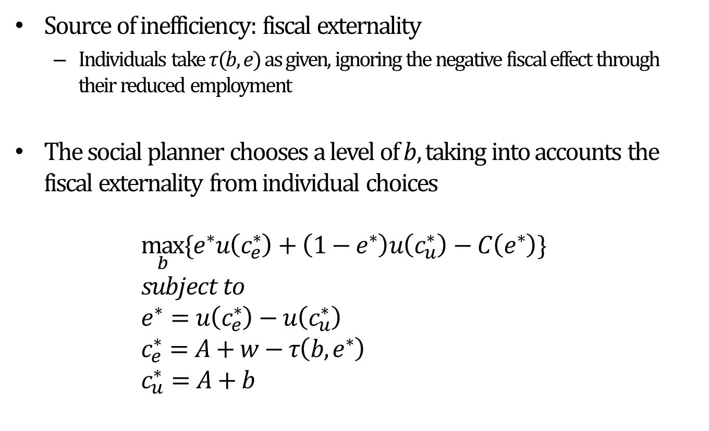
Simple Labor Market Model
Source of inefficiency: fiscal externality
Individuals take $τ(b,e)$ as given, ignoring the negative fiscal effect through their reduced employment
The social planner chooses a level of $b$, taking into accounts the fiscal externality from individual choices $\max_{b}{\{e^{∗}u\left(c_{e}^{∗}\right)+\left(1−e^{∗}\right)u\left(c_{u}^{∗}\right)−C\left(e^{∗}\right)\}}$ $subject to$ $e^{∗}=u\left(c_{e}^{∗}\right)−u\left(c_{u}^{∗}\right)$ $c_{e}^{∗}=A+w−τ\left(b,e^{∗}\right)$ $c_{u}^{∗}=A+b$

Slide 14
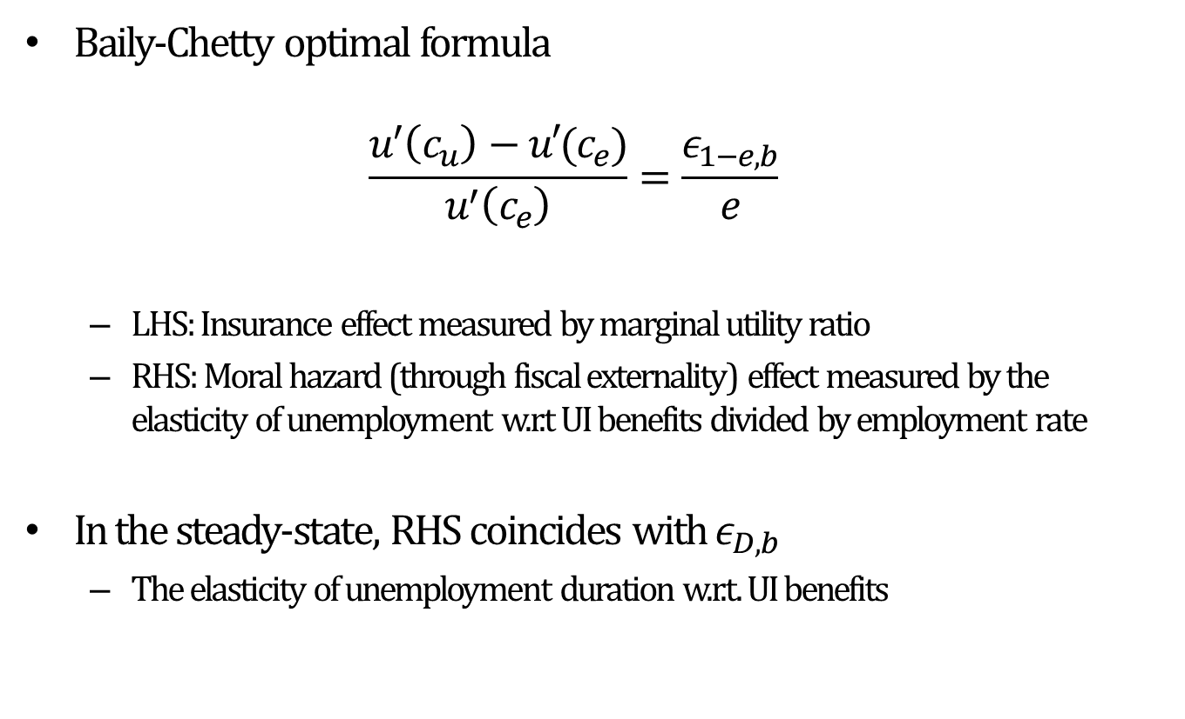
Simple Labor Market Model
Baily-Chetty optimal formula $\frac{u^{′}\left(c_{u}\right)−u′(c_{e})}{u^{′}\left(c_{e}\right)}=\frac{ε_{1−e,b}}{e}$
LHS: Insurance effect measured by marginal utility ratio
RHS: Moral hazard (through fiscal externality) effect measured by the elasticity of unemployment w.r.t UI benefits divided by employment rate
In the steady-state, RHS coincides with $ε_{D,b}$
The elasticity of unemployment duration w.r.t. UI benefits

Slide 15
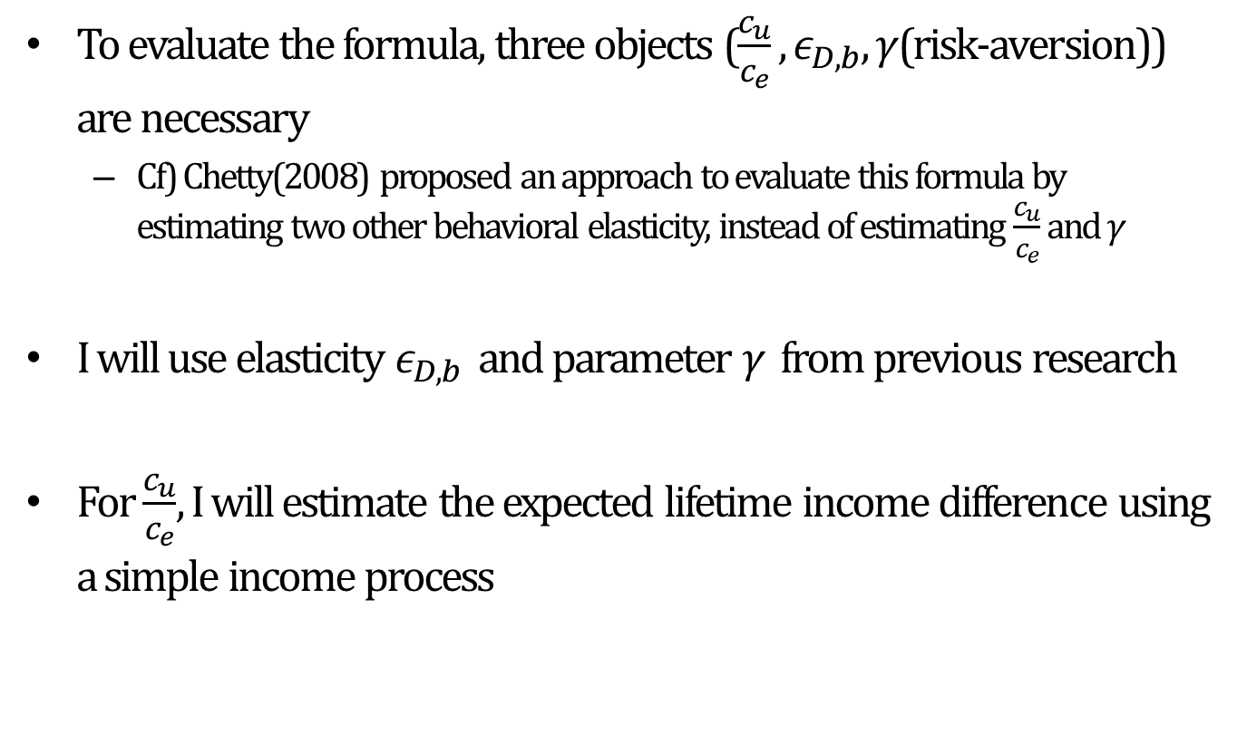
Evaluation of UI in Korea
To evaluate the formula, three objects ($\frac{c_{u}}{c_{e}}, ε_{D,b},γ$(risk-aversion)) are necessary
Cf) Chetty(2008) proposed an approach to evaluate this formula by estimating two other behavioral elasticity, instead of estimating $\frac{c_{u}}{c_{e}}$ and $γ$
I will use elasticity $ε_{D,b}$ and parameter $γ$ from previous research
For $\frac{c_{u}}{c_{e}}$, I will estimate the expected lifetime income difference using a simple income process

Slide 16
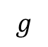
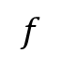
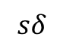
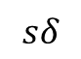
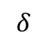
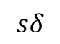
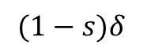
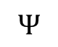
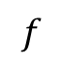
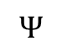
Income Process
High-income state
$$(1−s)δ$$
Employed
(w1)
Unemployed (High)
$$Ψ$$
$$f$$
OLF
$$sδ$$
$$sδ$$
$$g$$
$$sδ$$
$$δ$$
$$Ψ$$
Employed
(w0)
Unemployed (Low)
$$f$$
Low-income state

Slide 17
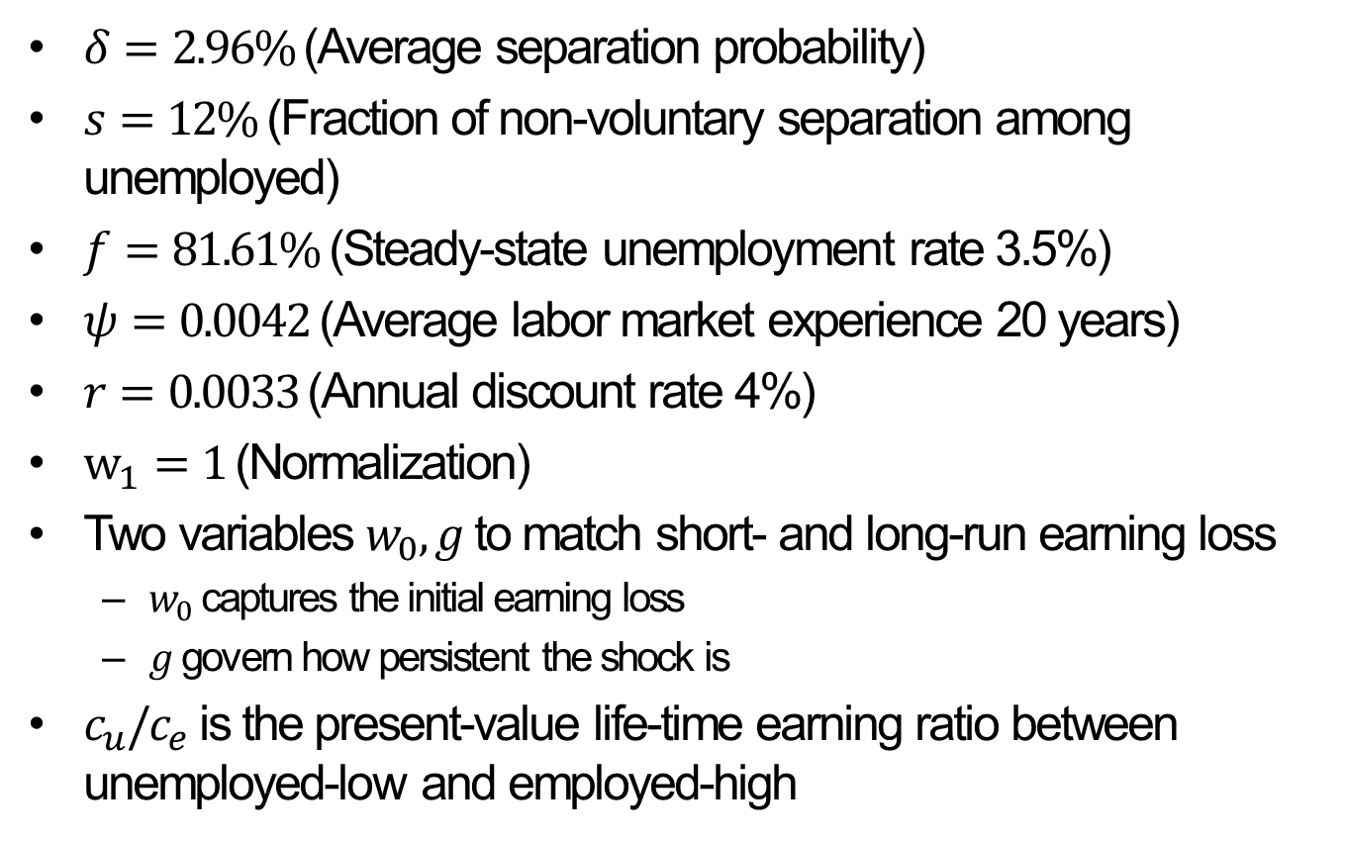
Income Process
$δ=2.96\%$(Average separation probability)
$s=12\%$(Fraction of non-voluntary separation among unemployed)
$f=81.61\%$(Steady-state unemployment rate 3.5%)
$ψ=0.0042$(Average labor market experience 20 years)
$r=0.0033$(Annual discount rate 4%)
$w_{1}=1$(Normalization)
Two variables $w_{0},g$ to match short- and long-run earning loss
$w_{0}$ captures the initial earning loss
$g$ govern how persistent the shock is
$c_{u}/c_{e}$ is the present-value life-time earning ratio between unemployed-low and employed-high

Slide 18
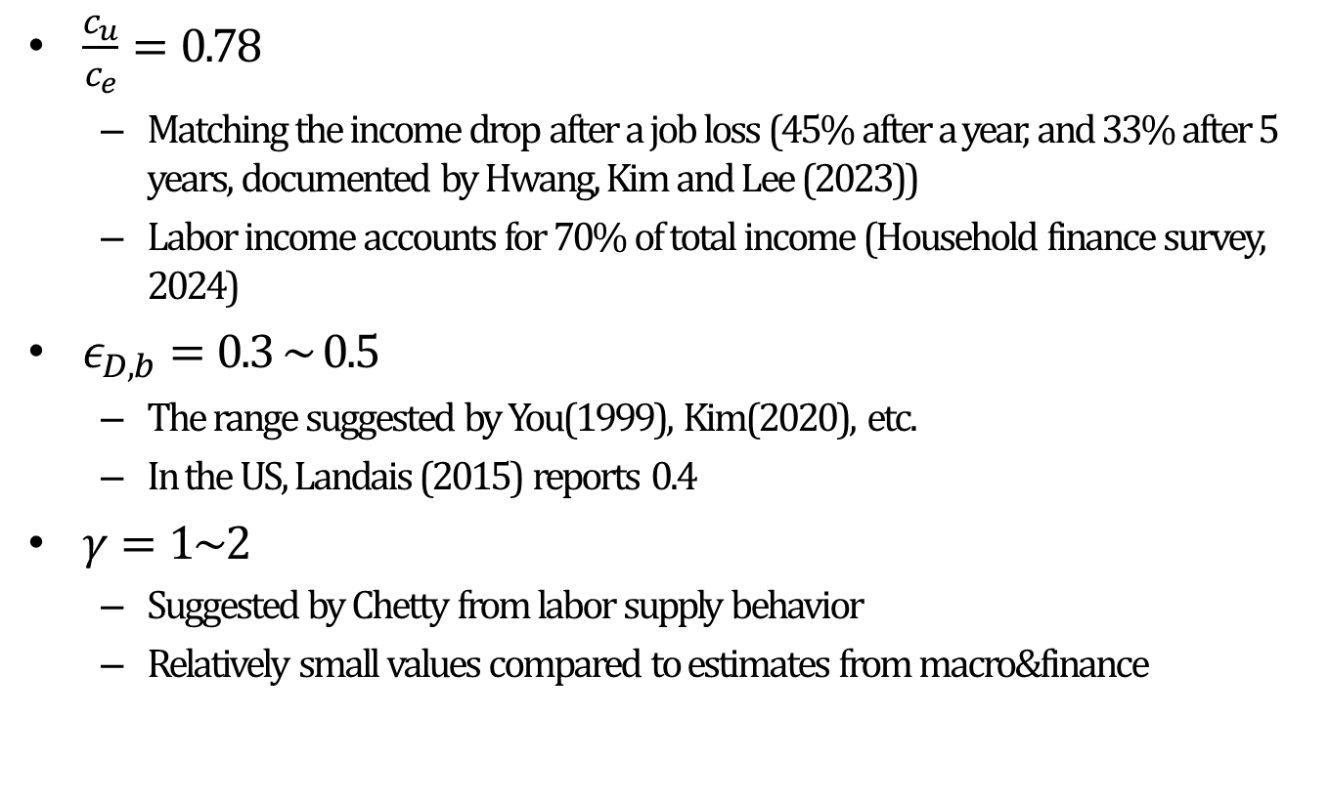
Parameter values
$\frac{c_{u}}{c_{e}}=0.78$
Matching the income drop after a job loss (45% after a year, and 33% after 5 years, documented by Hwang, Kim and Lee (2023))
Labor income accounts for 70% of total income (Household finance survey, 2024)
$ε_{D,b}=0.3 \sim 0.5$
The range suggested by You(1999), Kim(2020), etc.
In the US, Landais (2015) reports 0.4
$γ=1\sim 2$
Suggested by Chetty from labor supply behavior
Relatively small values compared to estimates from macro&finance

Slide 19
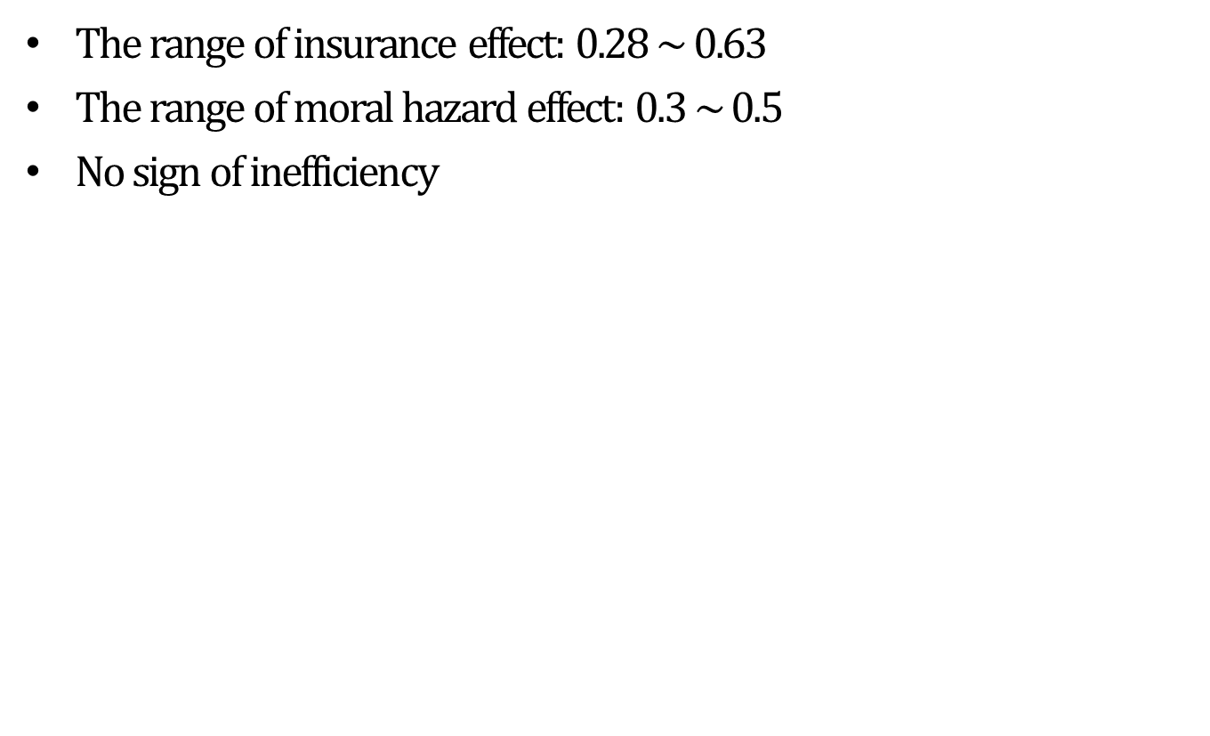
Evaluation of UI in Korea
The range of insurance effect: $0.28 \sim 0.63$
The range of moral hazard effect: $0.3 \sim 0.5$
No sign of inefficiency
Insurance effect
Moral hazard effect
0
Size of effects

Slide 20
Consideration of the Elderly UI
The elderly is likely to have different labor supply elasticity regarding the UI
For instance, the elderly can respond to UI by early retiring
The insurance effects also differ because
The direct cost of a job loss will differ (assumed to be identical)
The remaining lifetime will differ
Labor income portion will differ

Slide 21
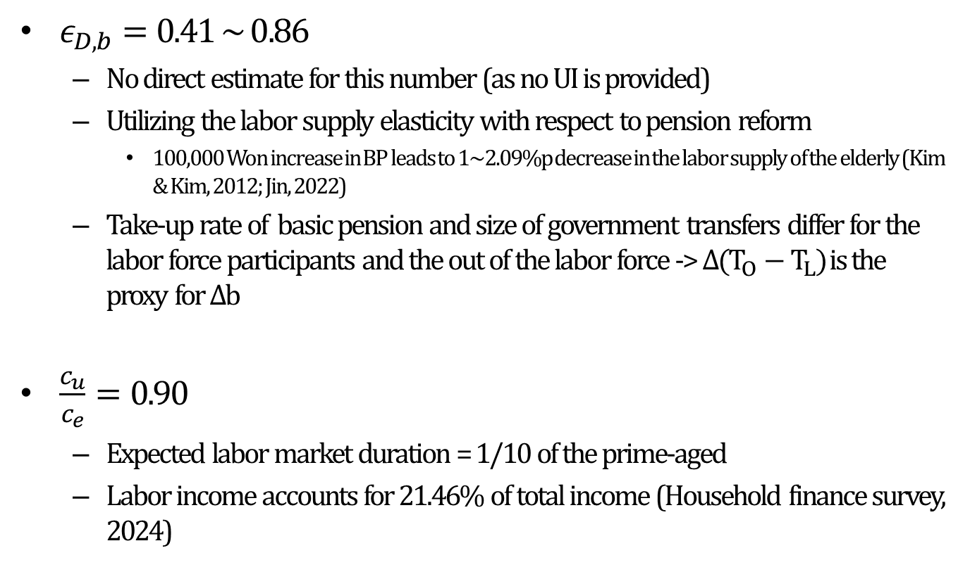
Parameter Values
$ε_{D,b}=0.41 \sim 0.86$
No direct estimate for this number (as no UI is provided)
Utilizing the labor supply elasticity with respect to pension reform
100,000 Won increase in BP leads to 1~2.09%p decrease in the labor supply of the elderly (Kim & Kim, 2012; Jin, 2022)
Take-up rate of basic pension and size of government transfers differ for the labor force participants and the out of the labor force -> $Δ(T_{O}−T_{L})$ is the proxy for $Δb$
$\frac{c_{u}}{c_{e}}=0.90$
Expected labor market duration = 1/10 of the prime-aged
Labor income accounts for 21.46% of total income (Household finance survey, 2024)

Slide 22
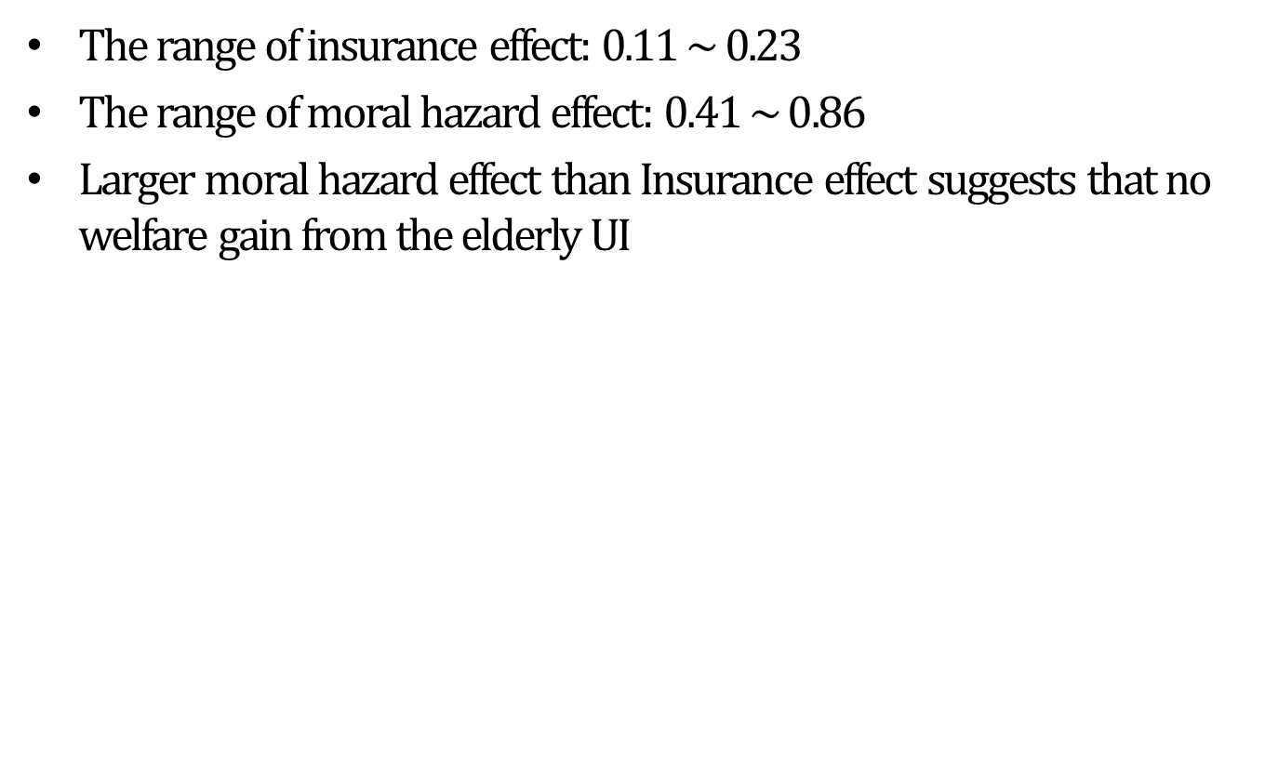
Evaluation of the Elderly UI in Korea
The range of insurance effect: $0.11 \sim 0.23$
The range of moral hazard effect: $0.41 \sim 0.86$
Larger moral hazard effect than Insurance effect suggests that no welfare gain from the elderly UI
Moral hazard effect
Insurance effect
0
Size of effects

Slide 23
What Drives the Results
Lower insurance effects due to a lower cost of a job loss
The permanent income difference between E and U individuals is not large for the elderly, even if the immediate earning loss is identical due to
Shorter expected labor market duration
Labor income is not the major source of income flow
The immediate earning loss is also likely lower for the elderly compared to prime-aged individuals, if one considers human capital accumulation
The moral hazard effects are larger
Partly because the old-age are marginally attached to the labor force

Slide 24
Discussions
The results only consider efficiency aspects, ignoring fairness concerns
The efficient UI should vary across the life-cycle, but the current system does not depend on age.
If a majority of the current elderly participate in the labor market, they will (and should) receive Unemployment Insurance (UI).
The inefficiency does not mean income support for the elderly is unnecessary
The poverty problem should be properly handled, but not necessarily through unemployment insurance

Slide 25
Conclusion
This project aims to answer whether introducing UI for the elderly is efficient
Using Baily-Chetty framework, this project concludes that the elderly UI is inefficient in Korea
Insurance effects are not large due to their smaller labor income share
Incentive costs are high because they are marginally attached to the labor market
The old-age poverty is better treated through the social security program, rather than UI

Slide 26
Thank you

